Slide 1
INFO-6088-(31)-25F Lab #4
Submitted by Brian Mwanjewe

Slide 2
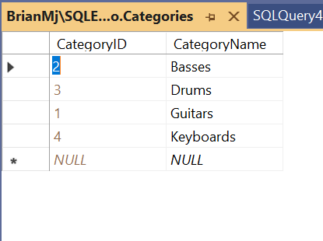
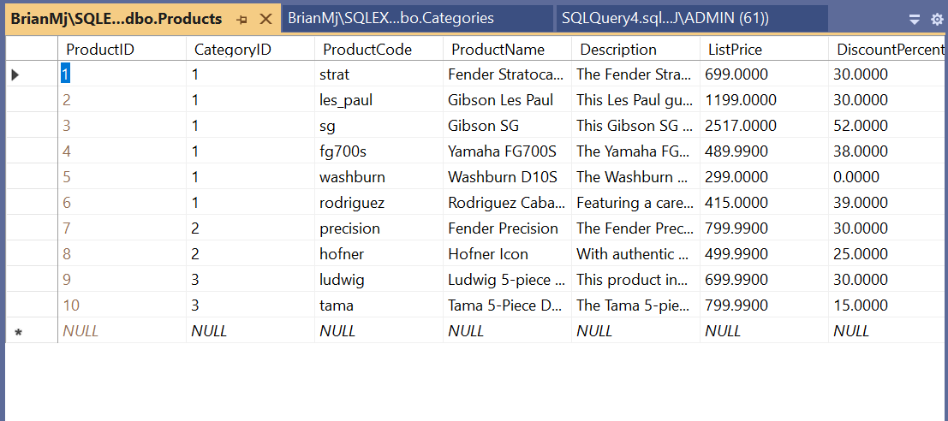
Chapter 1 Viewing data for Categories & Products tables

Slide 3
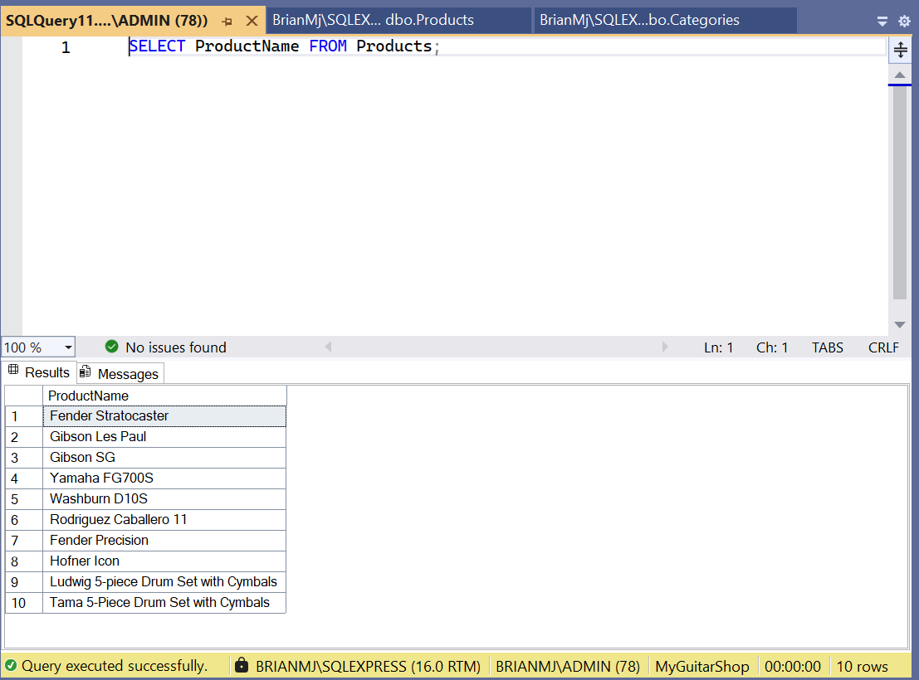
Basic SELECT statement

Slide 4
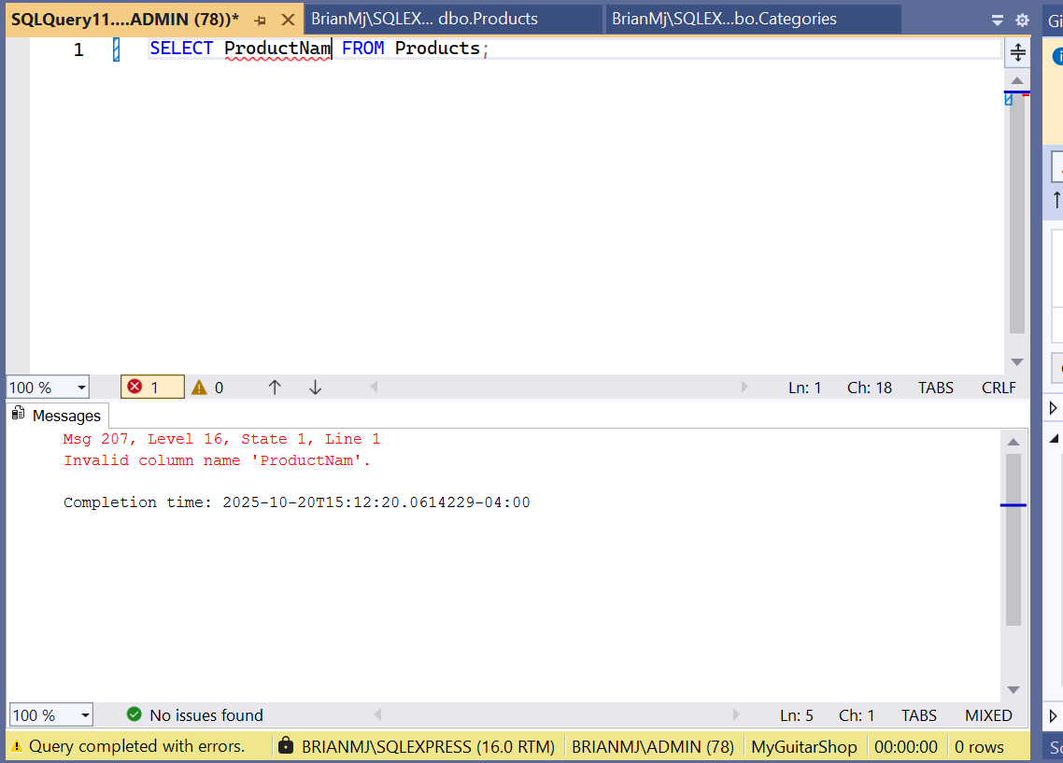
SELECT statement with an error

Slide 5
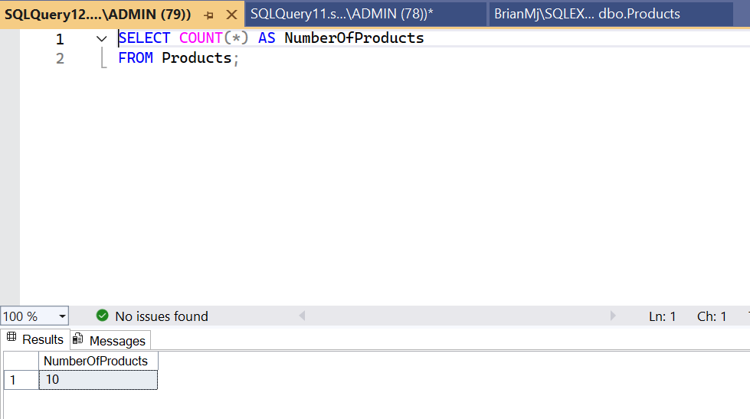
SELECT statement returning number of products

Slide 6
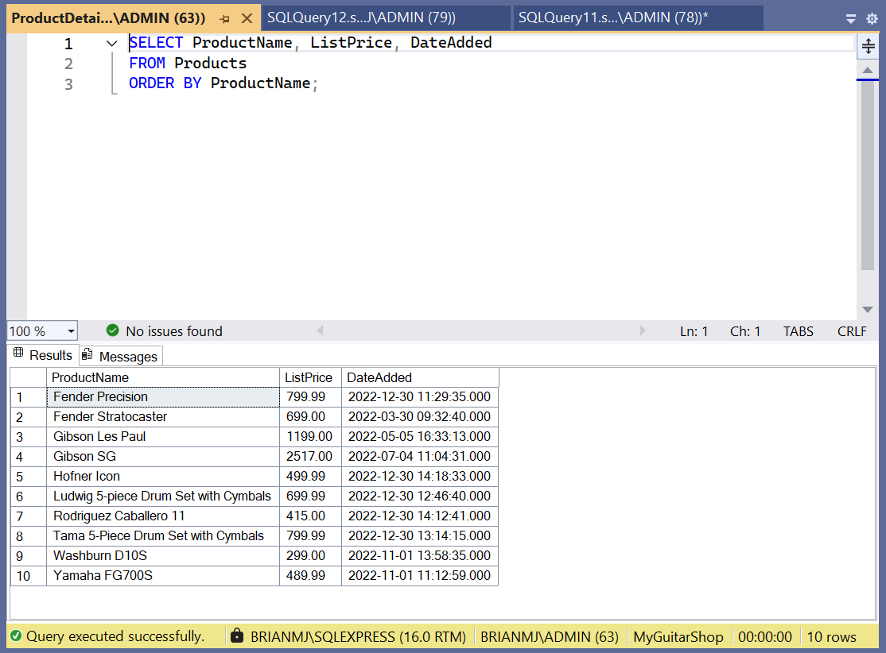
Running ProductDetails.sql script

Slide 7
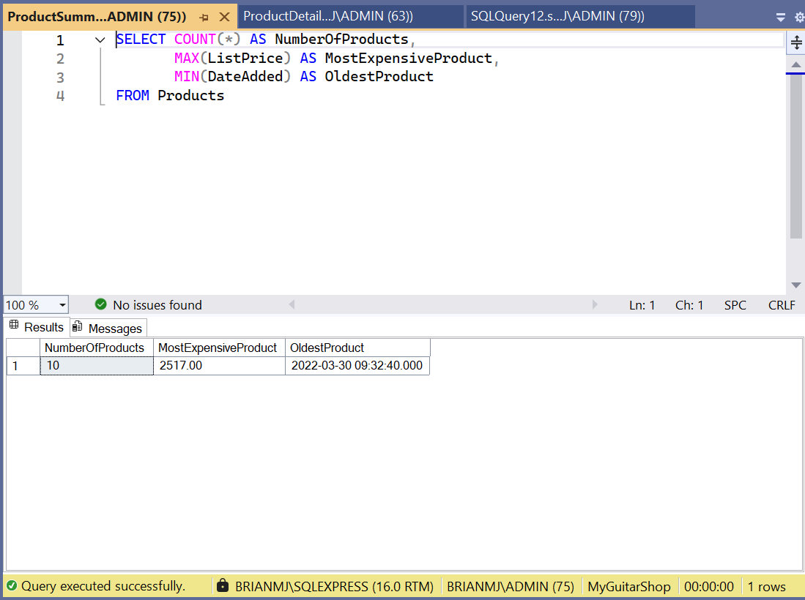
Running ProductSummary.sql script

Slide 8
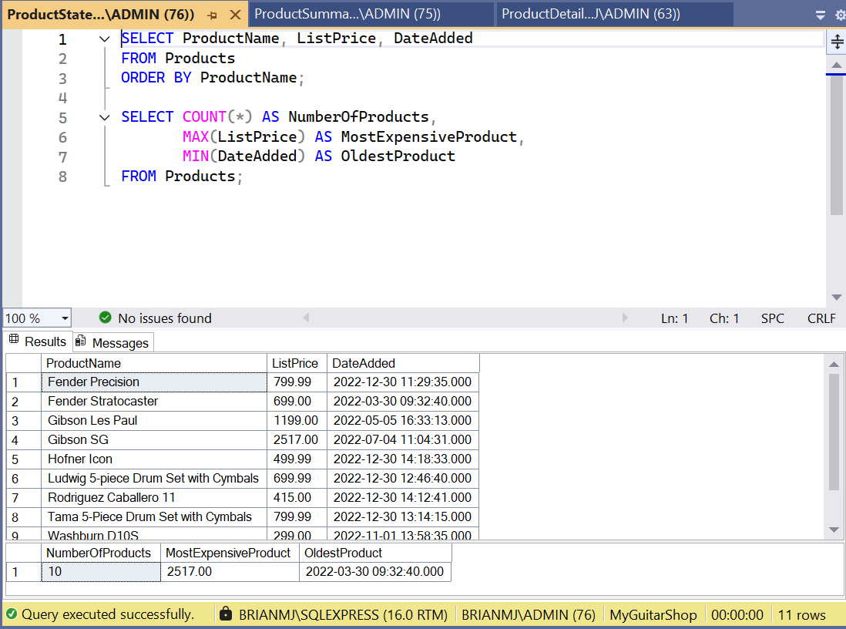
Running ProductStatements.sql script

Slide 9
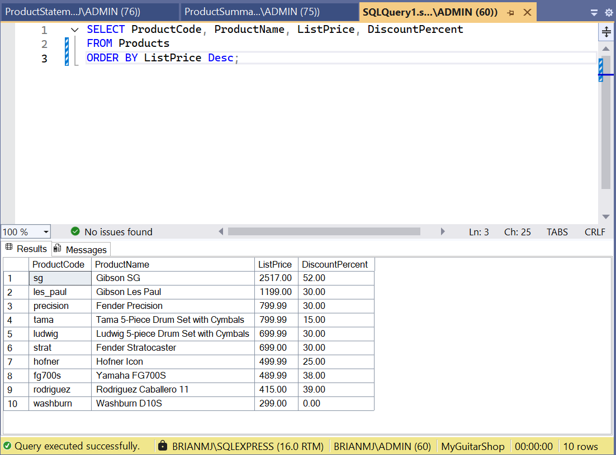
Chapter 3 1. ORDER BY ListPrice in Descending order

Slide 10
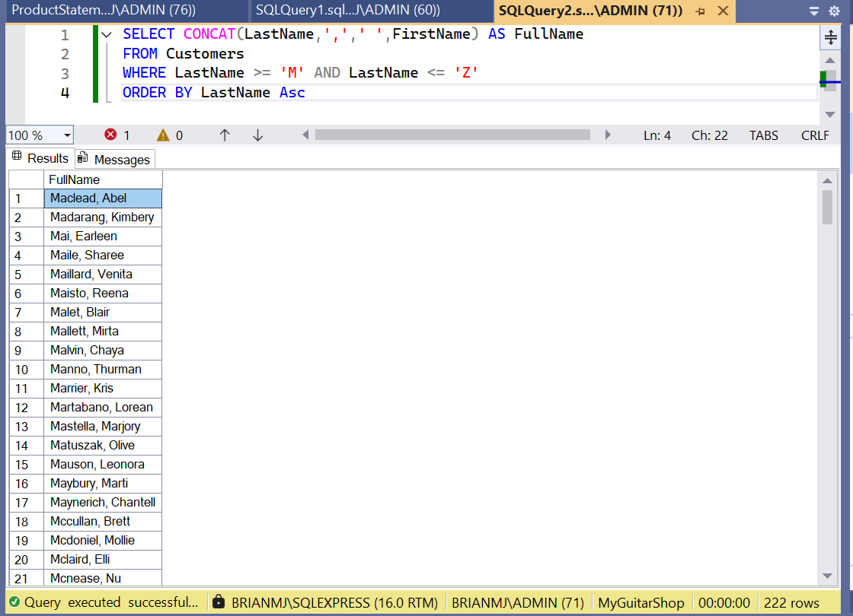
2. JOIN two columns FirstName & LastName

Slide 11
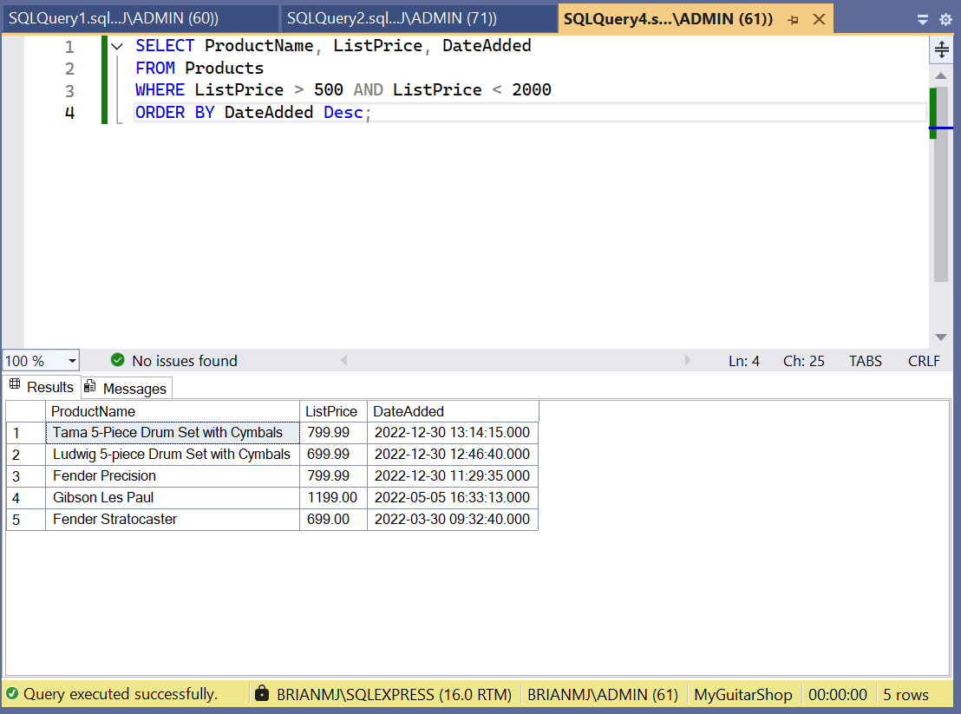
3. Returning ListPrice in a range

Slide 12
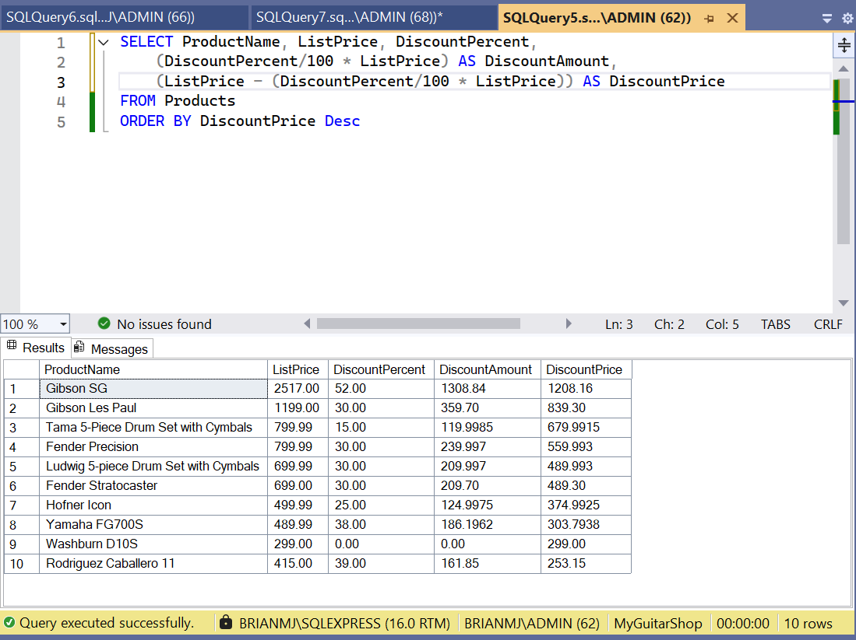
4. Calculating DiscountAmount and DiscountPrice from previous columns

Slide 13
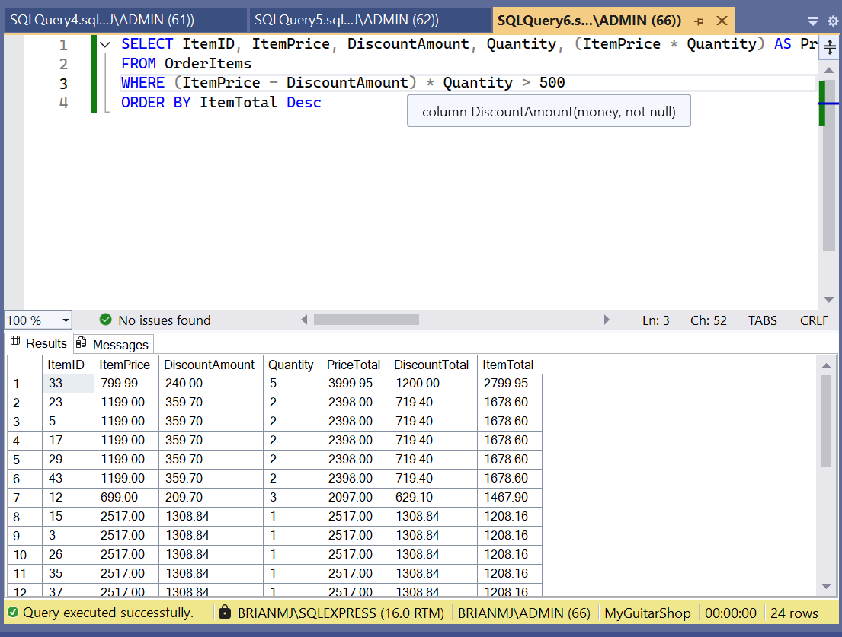
5. Calculating PriceTotal, DiscountTotal, ItemTotal and return rows ItemTotal > 500

Slide 14
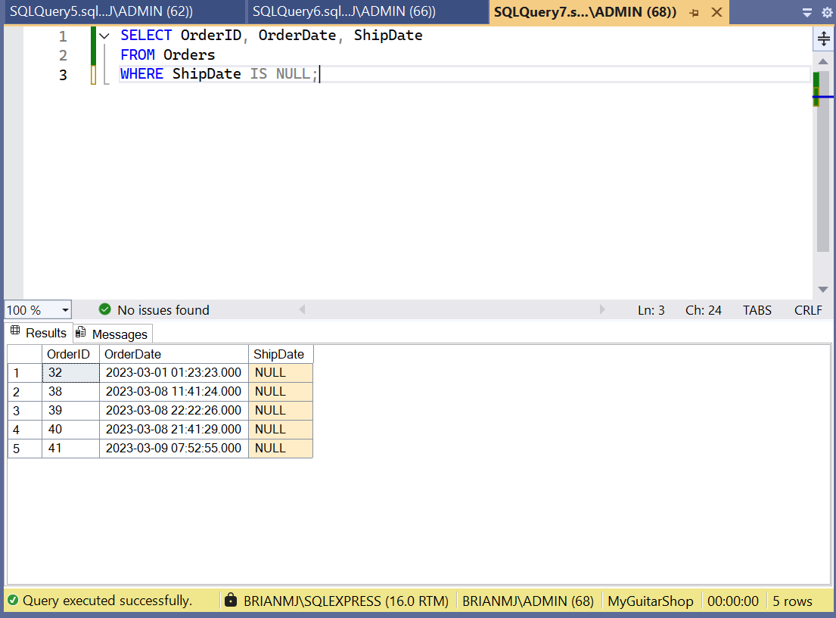
6. Returning ShipDate IS NULL

Slide 15
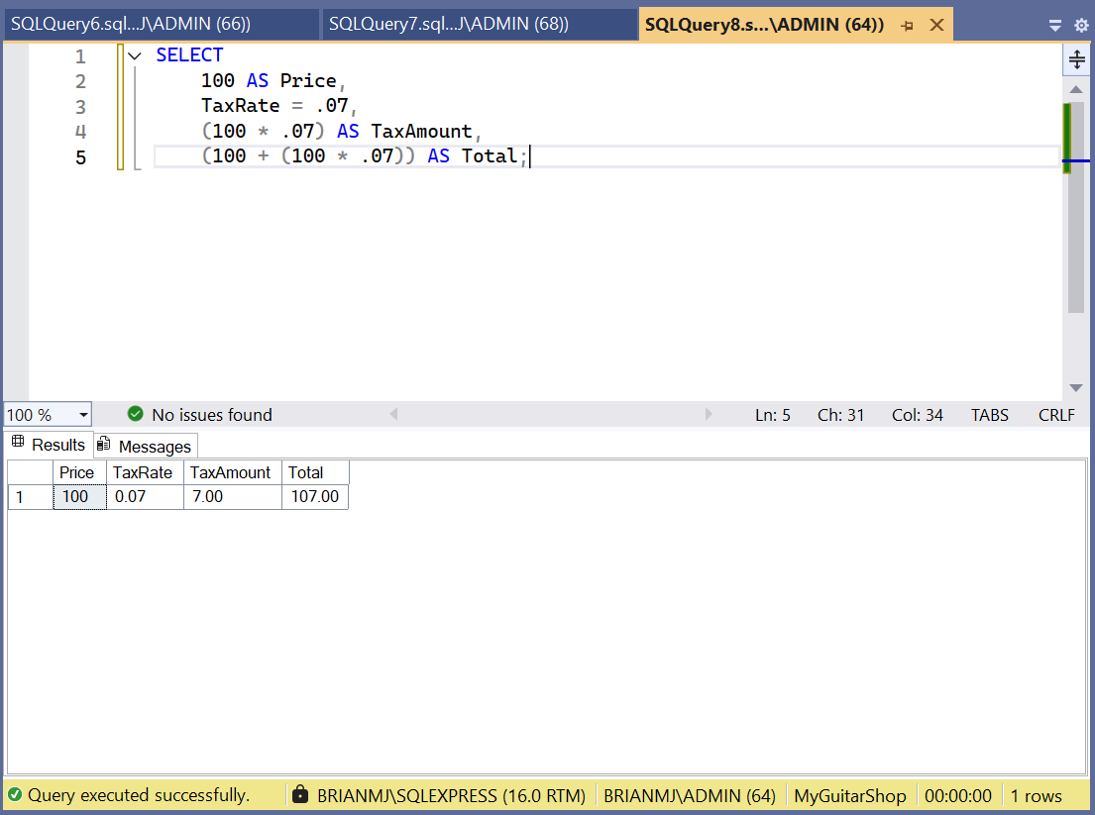
7. SELECT statement without FROM clause

